Slide 1
Data Mining:
Concepts and Techniques
(3rd ed.)
— Chapter 3 —
Jiawei Han, Micheline Kamber, and Jian Pei
University of Illinois at Urbana-Champaign &
Simon Fraser University
©2011 Han, Kamber & Pei. All rights reserved.

Slide 2
Chapter 3: Data Preprocessing
Data Preprocessing: An Overview
  Data Quality
  Major Tasks in Data Preprocessing
Data Cleaning
Data Integration
Data Reduction
Data Transformation and Data Discretization
Summary

Slide 3
Data Quality: Why Preprocess the Data?
Measures for data quality: A multidimensional view
  Accuracy: correct or wrong, accurate or not
  Completeness: not recorded, unavailable, …
  Consistency: some modified but some not, dangling, …
  Timeliness: timely update?
  Believability: how much the data are trusted by users?
  Interpretability: how easily the data can be understood?

Slide 4
Major Tasks in Data Preprocessing
Data cleaning
  Fill in missing values, smooth noisy data, identify or remove outliers, and resolve inconsistencies
Data integration
  Integration of multiple databases, data cubes, or files
Data reduction
  Dimensionality reduction
  Numerosity reduction
  Data compression
Data transformation and data discretization
  Normalization
  Concept hierarchy generation

Slide 5
Chapter 3: Data Preprocessing
Data Preprocessing: An Overview
  Data Quality
  Major Tasks in Data Preprocessing
Data Cleaning
Data Integration
Data Reduction
Data Transformation and Data Discretization
Summary

Slide 6
Data Cleaning
Data in the Real World Is Dirty: Lots of potentially incorrect data, e.g., instrument faulty, human or computer error, transmission error
  incomplete: lacking attribute values, lacking certain attributes of interest, or containing only aggregate data
    e.g., Occupation=“ ” (missing data)
  noisy: containing noise, errors, or outliers
    e.g., Salary=“−10” (an error)
  inconsistent: containing discrepancies in codes or names, e.g.,
    Age=“42”, Birthday=“03/07/2010”
    Was rating “1, 2, 3”, now rating “A, B, C”
    discrepancy between duplicate records
  Intentional (e.g., disguised missing data)
    Jan. 1 as everyone’s birthday?

Slide 7
Incomplete (Missing) Data
Data is not always available
  E.g., many tuples have no recorded value for several attributes, such as customer income in sales data
Missing data may be due to
  equipment malfunction
  inconsistent with other recorded data and thus deleted
  data not entered due to misunderstanding
  certain data may not be considered important at the time of entry
  not register history or changes of the data
Missing data may need to be inferred

Slide 8
How to Handle Missing Data?
Ignore the tuple: usually done when class label is missing (when doing classification)—not effective when the % of missing values per attribute varies considerably
Fill in the missing value manually: tedious + infeasible?
Fill in it automatically with
  a global constant : e.g., “unknown”, a new class?!
  the attribute mean
  the attribute mean for all samples belonging to the same class: smarter
  the most probable value: inference-based such as Bayesian formula or decision tree

Slide 9
Noisy Data
Noise: random error or variance in a measured variable
Incorrect attribute values may be due to
  faulty data collection instruments
  data entry problems
  data transmission problems
  technology limitation
  inconsistency in naming convention
Other data problems which require data cleaning
  duplicate records
  incomplete data
  inconsistent data

Slide 10
How to Handle Noisy Data?
Binning
  first sort data and partition into (equal-frequency) bins
  then one can smooth by bin means, smooth by bin median, smooth by bin boundaries, etc.
Regression
  smooth by fitting the data into regression functions
Clustering
  detect and remove outliers
Combined computer and human inspection
  detect suspicious values and check by human (e.g., deal with possible outliers)

Slide 11
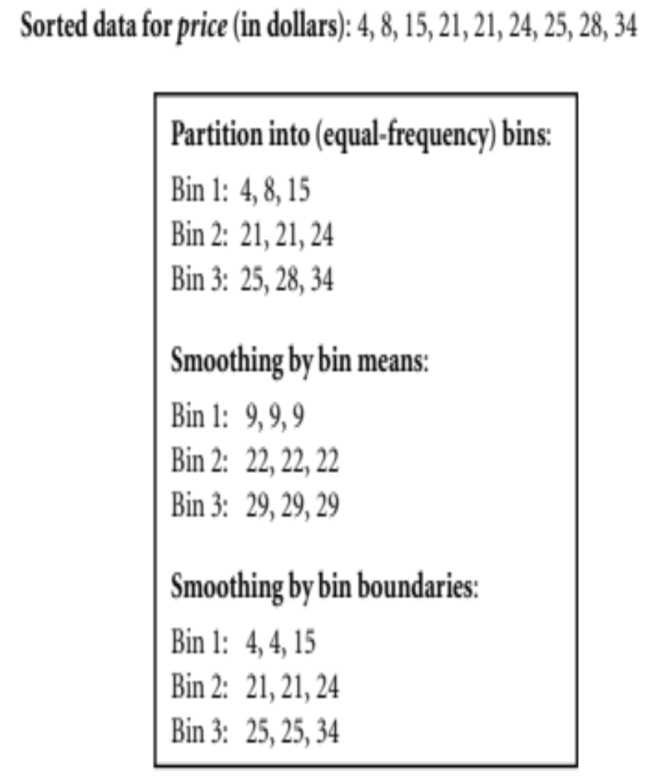
Binning
  Binning methods smooth a sorted data value by consulting its “neighborhood,” that is, the values around it.
  The sorted values are distributed into a number of “buckets,” or bins (partition into (equal-frequency) bins)
  Smoothing:
    Smoothing by bin means, smoothing by bin median, smoothing by bin boundaries

Slide 12
Regression
  Data smoothing can also be done by regression, a technique that conforms data values to a function.
  Linear regression involves finding the “best” line to fit two attributes (or variables) so that one attribute can be used to predict the other.
    Example: predict weight if we knew an individual's height
  Multiple linear regression is an extension of linear regression, where more than two attributes are involved and the data are fit to a multidimensional surface.
    Example: Prediction of CO2 emission based on engine size and number of cylinders in a car.
    Predicting a student's exam score based on study hours and sleep hours.

Slide 13
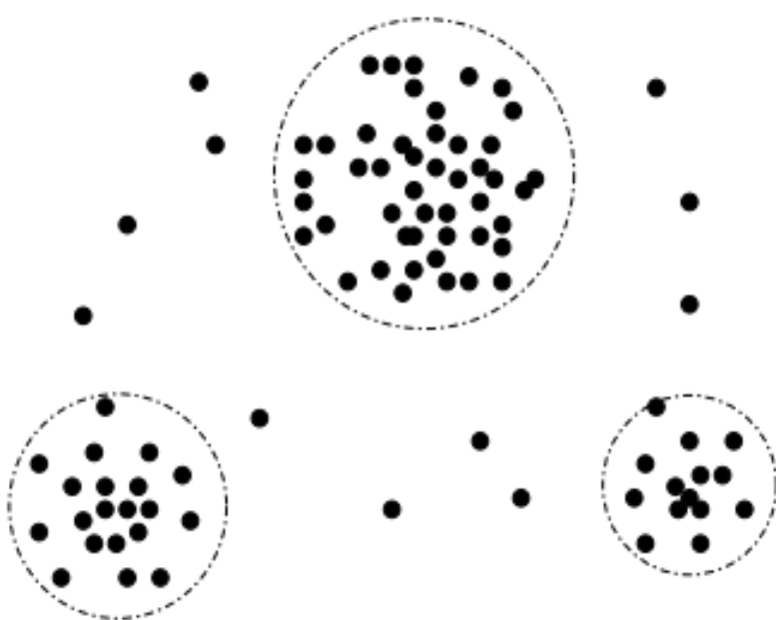
Outlier analysis
  Outliers may be detected by clustering
  Intuitively, values that fall outside of the set of clusters may be considered outliers

Slide 14
Data Cleaning as a Process
Steps
Data discrepancy detection
  Use metadata (e.g., domain, range, dependency, distribution)
  Check field overloading
  Check uniqueness rule, consecutive rule and null rule(blanks,?,special charecters,other strings)
  Use commercial tools
    Data scrubbing: use simple domain knowledge (e.g., postal code, spell-check) to detect errors and make corrections
    Data auditing: by analyzing data to discover rules and relationship to detect violators (e.g., correlation and clustering to find outliers)
Data migration and integration
  Data migration tools: allow transformations to be specified
  ETL (Extraction/Transformation/Loading) tools: allow users to specify transformations through a graphical user interface
Integration of the two processes
  Iterative and interactive (e.g., Potter’s Wheels)

Slide 15
Chapter 3: Data Preprocessing
Data Preprocessing: An Overview
  Data Quality
  Major Tasks in Data Preprocessing
Data Cleaning
Data Integration
Data Reduction
Data Transformation and Data Discretization
Summary

Slide 16
Data Integration
Data integration:
  Combines data from multiple sources into a coherent store
Schema integration: e.g., A.cust-id ≡ B.cust-#
  Integrate metadata from different sources
Entity identification problem:
  Identify real world entities from multiple data sources, e.g., Bill Clinton = William Clinton
Detecting and resolving data value conflicts
  For the same real world entity, attribute values from different sources are different
  Possible reasons: different representations, different scales, e.g., metric vs. British units

Slide 17
Handling Redundancy in Data Integration
Redundant data occur often when integration of multiple databases
  Object identification: The same attribute or object may have different names in different databases
  Derivable data: One attribute may be a “derived” attribute in another table, e.g., annual revenue
Redundant attributes may be able to be detected by correlation analysis and covariance analysis
Careful integration of the data from multiple sources may help reduce/avoid redundancies and inconsistencies and improve mining speed and quality

Slide 18

Correlation Analysis (Nominal Data)
Χ² (chi-square) test
The larger the Χ² value, the more likely the variables are related
The cells that contribute the most to the Χ² value are those whose actual count is very different from the expected count
Correlation does not imply causality
  # of hospitals and # of car-theft in a city are correlated
  Both are causally linked to the third variable: population

Slide 19
Chi-Square Calculation: An Example
Χ² (chi-square) calculation (numbers in parenthesis are expected counts calculated based on the data distribution in the two categories)
It shows that like_science_fiction and play_chess are correlated in the group
 | Play chess | Not play chess | Sum (row)
Like science fiction | 250(90) | 200(360) | 450
Not like science fiction | 50(210) | 1000(840) | 1050
Sum(col.) | 300 | 1200 | 1500

Slide 20
The magnitude of the Chi-Square statistic depends on:
  The degrees of freedom (df)
  The significance level (α) you choose (e.g., 0.05, 0.01)
How to interpret Chi-Square value properly?
1.Calculate Degrees of Freedom (df)
df=(r−1)(c−1)
Here,
r = number of rows = 2 (Like, Not like)
c = number of columns = 2 (Play, Not play)
So,
df=(2−1)(2−1)=1
Data Mining: Concepts and Techniques

Slide 21
2.Compare χ² to critical value from Chi-Square table
At α = 0.05 and df = 1,
the critical value = 3.841.
At α = 0.01,
critical value = 6.635.
Here χ² = 507.93
This is much greater than either critical value, indicating:
The probability of observing this by chance is extremely low.
Reject the null hypothesis of independence. There is an association.
Data Mining: Concepts and Techniques

Slide 22



Correlation Analysis (Numeric Data)
Correlation coefficient (also called Pearson’s product moment coefficient)
  where n is the number of tuples, and are the respective means of A and B, σ_{A} and σ_{B} are the respective standard deviation of A and B, and Σ(a_{i}b_{i}) is the sum of the AB cross-product.
If r_{A,B} > 0, A and B are positively correlated (A’s values increase as B’s). The higher, the stronger correlation.
r_{A,B} = 0: independent; r_{AB} < 0: negatively correlated

Slide 23

Visually Evaluating Correlation
Scatter plots showing the similarity from –1 to 1.

Slide 24



Correlation (viewed as linear relationship)
Correlation measures the linear relationship between objects
To compute correlation, we standardize data objects, A and B, and then take their dot product

Slide 25


Covariance (Numeric Data)
Covariance is similar to correlation
  where n is the number of tuples, and are the respective mean or expected values of A and B, σ_{A} and σ_{B} are the respective standard deviation of A and B.
Positive covariance: If Cov_{A,B} > 0, then A and B both tend to be larger than their expected values.
Negative covariance: If Cov_{A,B} < 0 then if A is larger than its expected value, B is likely to be smaller than its expected value.
Independence: Cov_{A,B} = 0 but the converse is not true:
  Some pairs of random variables may have a covariance of 0 but are not independent. Only under some additional assumptions (e.g., the data follow multivariate normal distributions) does a covariance of 0 imply independence
Correlation coefficient:

Slide 26

Co-Variance: An Example
It can be simplified in computation as
Suppose two stocks A and B have the following values in one week: (2, 5), (3, 8), (5, 10), (4, 11), (6, 14).
Question: If the stocks are affected by the same industry trends, will their prices rise or fall together?
  E(A) = (2 + 3 + 5 + 4 + 6)/ 5 = 20/5 = 4
  E(B) = (5 + 8 + 10 + 11 + 14) /5 = 48/5 = 9.6
  Cov(A,B) = (2×5+3×8+5×10+4×11+6×14)/5 − 4 × 9.6 = 4
Thus, A and B rise together since Cov(A, B) > 0.

Slide 27
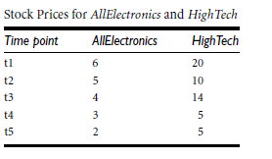

Practice Problem
Data Mining: Concepts and Techniques

Slide 28
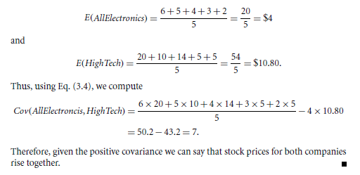
Solution
Data Mining: Concepts and Techniques

Slide 29
Chapter 3: Data Preprocessing
Data Preprocessing: An Overview
  Data Quality
  Major Tasks in Data Preprocessing
Data Cleaning
Data Integration
Data Reduction
Data Transformation and Data Discretization
Summary

Slide 30
Data Reduction Strategies
Data reduction: Obtain a reduced representation of the data set that is much smaller in volume but yet produces the same (or almost the same) analytical results
Why data reduction? — A database/data warehouse may store terabytes of data. Complex data analysis may take a very long time to run on the complete data set.
Data reduction strategies
  Dimensionality reduction, e.g., remove unimportant attributes
    Wavelet transforms
    Principal Components Analysis (PCA)
    Feature subset selection, feature creation
  Numerosity reduction (some simply call it: Data Reduction)
    Regression and Log-Linear Models
    Histograms, clustering, sampling
    Data cube aggregation
  Data compression

Slide 31
Data Reduction 1: Dimensionality Reduction
Curse of dimensionality
  When dimensionality increases, data becomes increasingly sparse
  Density and distance between points, which is critical to clustering, outlier analysis, becomes less meaningful
  The possible combinations of subspaces will grow exponentially
Dimensionality reduction
  Avoid the curse of dimensionality
  Help eliminate irrelevant features and reduce noise
  Reduce time and space required in data mining
  Allow easier visualization
Dimensionality reduction techniques
  Wavelet transforms
  Principal Component Analysis
  Supervised and nonlinear techniques (e.g., feature selection)

Slide 32

What Is Wavelet Transform?
Decomposes a signal into different frequency subbands
  Applicable to n-dimensional signals
Data are transformed to preserve relative distance between objects at different levels of resolution
Allow natural clusters to become more distinguishable
Used for image compression

Slide 33
Wavelet Transformation
Haar2
Db4
Discrete wavelet transform (DWT) for linear signal processing and multi-resolution analysis
Breaks down signals into components at different frequency levels with spatial localization.
Compressed approximation: store only a small fraction of the strongest of the wavelet coefficients
Similar to discrete Fourier transform (DFT), but better lossy compression, localized in space(it captures both time and frequency information, unlike DFT which only works in frequency domain.
A mathematical technique for analyzing signals or images at different scales or resolutions.

Slide 34
Wavelet | Shape | Smoothness | Support | Use Case
Haar2 | Blocky/Square | Low | Very small | Simple tasks, edge detection
Daubechies4 | Smooth with oscillations | High | Larger | Signal compression, denoising, feature-rich analysis
Method:
  Length, L, must be an integer power of 2 (padding with 0’s, when necessary)
  Each transform has 2 functions: smoothing, difference
  Applies to pairs of data, resulting in two set of data of length L/2
  Applies two functions recursively, until reaches the desired length

Slide 35
Step-wise procedure of DWT:
1.Input length constraint
  The input signal length L should be a power of 2 (pad with zeros if needed).
2.Two functions per transform
  Smoothing (Low-pass filter): captures average trend or approximation.
  Difference (High-pass filter): captures detailed variations or edges.
3.Pairwise operation
  The transform is applied to pairs of data points, producing two outputs each of length L/2:
  One for smoothed (approximation) coefficients.
  One for difference (detail) coefficients.
4.Recursive application
  This process is repeated on the smoothed output recursively until the desired level of decomposition is reached.
  Selected values from the dataset obtained in the previous iterations are designated the wavelet coefficients of the transformed data.

Slide 36
Why Wavelet Transform?
Use hat-shape filters
  Emphasize region where points cluster
  Suppress weaker information in their boundaries
Effective removal of outliers
  Insensitive to noise, insensitive to input order
Multi-resolution
  Detect arbitrary shaped clusters at different scales
Efficient
  Complexity O(N)
Only applicable to low dimensional data

Slide 37
Principal Component Analysis (PCA)
Find a projection that captures the largest amount of variation in data
The original data are projected onto a much smaller space, resulting in dimensionality reduction. We find the eigenvectors of the covariance matrix, and these eigenvectors define the new space
x₂
e
x₁

Slide 38
Principal Component Analysis (Steps)
Given N data vectors from n-dimensions, find k ≤ n orthogonal vectors (principal components) that can be best used to represent data
  Normalize input data: Each attribute falls within the same range
  Compute k orthonormal (unit) vectors, i.e., principal components
  Each input data (vector) is a linear combination of the k principal component vectors
  The principal components are sorted in order of decreasing “significance” or strength
  Since the components are sorted, the size of the data can be reduced by eliminating the weak components, i.e., those with low variance (i.e., using the strongest principal components, it is possible to reconstruct a good approximation of the original data)
Works for numeric data only

Slide 39
Attribute Subset Selection
Another way to reduce dimensionality of data
Redundant attributes
  Duplicate much or all of the information contained in one or more other attributes
  E.g., purchase price of a product and the amount of sales tax paid
Irrelevant attributes
  Contain no information that is useful for the data mining task at hand
  E.g., students' ID is often irrelevant to the task of predicting students' GPA

Slide 40
Heuristic Search in Attribute Selection
There are 2^{d} possible attribute combinations of d attributes
Typical heuristic attribute selection methods:
1. Stepwise forward selection
  add best attribute
2. Stepwise backward elimination
  removes worst attribute
3. combination of forward selection and backward elimination
  Add best, remove worst in remaining attribute
4. Decision Tree induction
  For classification
  Form tree using reduces subset of attributes
  Flowchart like structure
  Internal node (attribute), leaf node(class prediction)

Slide 41
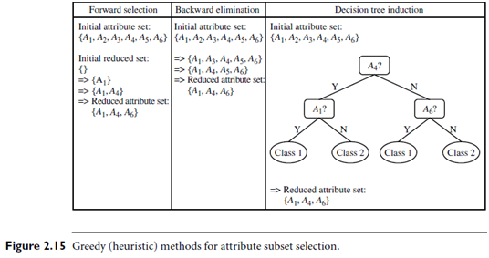

Slide 42
Suppose we start with an empty set {} and a target variable Y.
We evaluate each individual attribute:
Accuracy with {A₁} = 70%
Accuracy with {A₂} = 60%
Accuracy with {A₃} = 72%
✅ Add A₃ first.
Next step: Evaluate:
{A₃, A₁} → 78%
{A₃, A₂} → 71%
✅ Add A₁. Continue until adding new attributes no longer improves performance significantly.
Here is a list of common metrics used in forward selection:
Classification Accuracy
Error Rate
Information Gain
Gini Index
Mutual Information
Correlation Coefficient
AUC-ROC Score
Cross-validation Score
Precision, Recall, F1-Score
Mean Squared Error (for regression)

Slide 43
Data Reduction 2: Numerosity Reduction
Reduce data volume by choosing alternative, smaller forms of data representation
Parametric methods (e.g., regression)
  Assume the data fits some model, estimate model parameters, store only the parameters, and discard the data (except possible outliers)
  Ex.: Log-linear models—obtain value at a point in m-D space as the product on appropriate marginal subspaces
Non-parametric methods
  Do not assume models
  Major families: histograms, clustering, sampling, …

Slide 44
Parametric Data Reduction: Regression and Log-Linear Models
Linear regression
  Data modeled to fit a straight line
  Often uses the least-square method to fit the line
Multiple regression
  Allows a response variable Y to be modeled as a linear function of multidimensional feature vector
Log-linear model
  Approximates discrete multidimensional probability distributions

Slide 45
Regression Analysis
y
Actual
Y1
Regression analysis: A collective name for techniques for the modeling and analysis of numerical data consisting of values of a dependent variable (also called response variable or measurement) and of one or more independent variables (aka. explanatory variables or predictors)
The parameters are estimated so as to give a "best fit" of the data
Most commonly the best fit is evaluated by using the least squares method, but other criteria have also been used
Y1’
Predicted
y = x + 1
X1
x
Used for prediction (including forecasting of time-series data), inference, hypothesis testing, and modeling of causal relationships

Slide 46
Regress Analysis and Log-Linear Models
Linear regression: Y = w X + b
  Two regression coefficients, w and b, specify the line and are to be estimated by using the data at hand
  Using the least squares criterion to the known values of Y₁, Y₂, …, X₁, X₂, ….
Multiple regression: Y = b₀ + b₁ X₁ + b₂ X₂
  Many nonlinear functions can be transformed into the above
Log-linear models:
  Approximate discrete multidimensional probability distributions
  Estimate the probability of each point (tuple) in a multi-dimensional space for a set of discretized attributes, based on a smaller subset of dimensional combinations
  Useful for dimensionality reduction and data smoothing

Slide 47

Histogram Analysis
Divide data into buckets and store average (sum) for each bucket
Partitioning rules:
  Equal-width: equal bucket range
  Equal-frequency (or equal-depth)

Slide 48
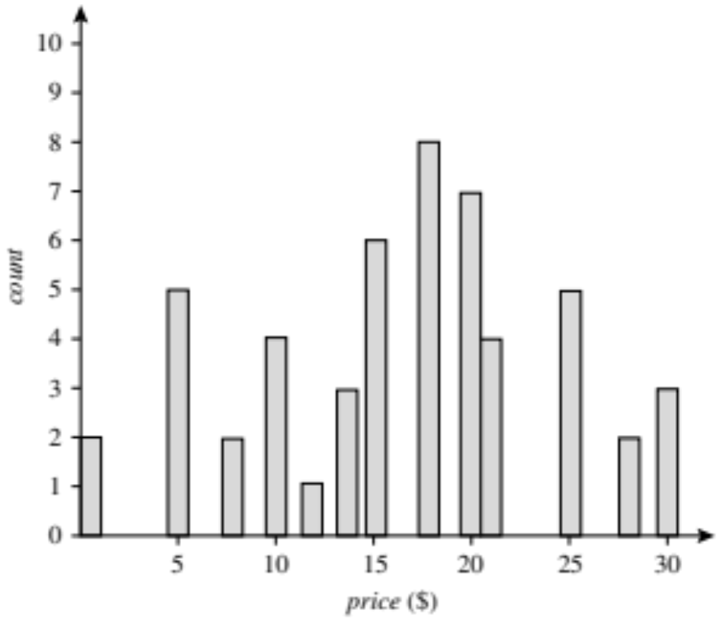
Example:
The following data are a list of AllElectronics prices for commonly sold items (rounded to the nearest dollar).
The numbers have been sorted: 1, 1, 5, 5, 5, 5, 5, 8, 8, 10, 10, 10, 10, 12, 14, 14, 14, 15, 15, 15, 15, 15, 15, 18, 18, 18, 18, 18, 18, 18, 18, 20, 20, 20, 20, 20, 20, 20, 21, 21, 21, 21, 25, 25, 25, 25, 25, 28, 28, 30, 30, 30.
A histogram for price using singleton buckets each bucket represents one price–value/ frequency pair.

Slide 49
Clustering
Partition data set into clusters based on similarity, and store cluster representation (e.g., centroid and diameter) only
Can be very effective if data is clustered but not if data is “smeared”
Can have hierarchical clustering and be stored in multi-dimensional index tree structures
There are many choices of clustering definitions and clustering algorithms

Slide 50
Sampling
Sampling: obtaining a small sample s to represent the whole data set N
Allow a mining algorithm to run in complexity that is potentially sub-linear to the size of the data
Key principle: Choose a representative subset of the data
  Simple random sampling may have very poor performance in the presence of skew
  Develop adaptive sampling methods, e.g., stratified sampling:

Slide 51
Types of Sampling
Simple random sampling
  There is an equal probability of selecting any particular item
Sampling without replacement
  Once an object is selected, it is removed from the population
Sampling with replacement
  A selected object is not removed from the population
Stratified sampling:
  Partition the data set, and draw samples from each partition (proportionally, i.e., approximately the same percentage of the data)
  Used in conjunction with skewed data(a dataset where the values (or classes) are not evenly distributed.)

Slide 52
Sampling: With or without Replacement
Without duplicate
SRSWOR
(simple random
sample without
replacement)
With duplicate
SRSWR
Raw Data

Slide 53
Stratified Sampling Example
Definition: The population is divided into distinct subgroups (strata) based on a characteristic (e.g., age, gender, income), and samples are randomly selected from each stratum.
Example:
You want to study students' academic performance in a university.
Strata: Undergraduate, Master's, and PhD students.
You randomly select 30 undergraduates, 20 Master's, and 10 PhDs from each group, ensuring representation of all academic levels.
Data Mining: Concepts and Techniques

Slide 54
Sampling: Cluster or Stratified Sampling
Raw Data
Cluster/Stratified Sample

Slide 55
Data Cube Aggregation
The lowest level of a data cube (base cuboid)
  The aggregated data for an individual entity of interest
  E.g., a customer in a phone calling data warehouse
Multiple levels of aggregation in data cubes
  Further reduce the size of data to deal with
Reference appropriate levels
  Use the smallest representation which is enough to solve the task
Queries regarding aggregated information should be answered using data cube, when possible

Slide 56
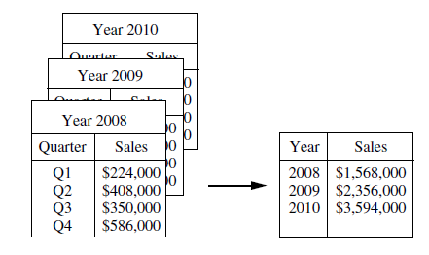
Data Cube Aggregation:Example
Imagine that you have collected the data for your analysis.
These data consist of the AllElectronics sales per quarter, for the years 2008 to 2010.
You are interested in the annual sales (total per year), rather than the total per quarter.
Thus, the data can be aggregated so that the resulting data summarize the total sales per year instead of per quarter.
This aggregation is illustrated in Figure.
The resulting data set is smaller in volume, without loss of information necessary for the analysis task.

Slide 57
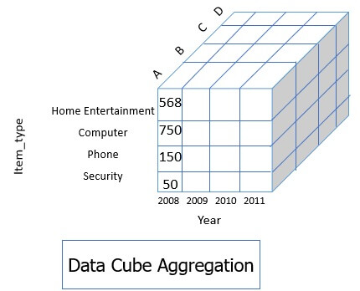
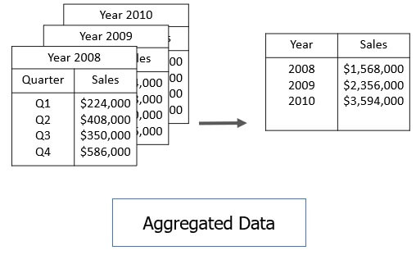

Slide 58
Data Reduction 3: Data Compression
String compression
  There are extensive theories and well-tuned algorithms
  Typically lossless, but only limited manipulation is possible without expansion
Audio/video compression
  Typically, lossy compression, with progressive refinement
  Sometimes small fragments of signal can be reconstructed without reconstructing the whole
Time sequence is not audio
  Typically, short and vary slowly with time
Dimensionality and numerosity reduction may also be considered as forms of data compression

Slide 59
Data Compression
Original Data
Compressed
Data
lossless
Original Data
Approximated
lossy

Slide 60
Chapter 3: Data Preprocessing
Data Preprocessing: An Overview
  Data Quality
  Major Tasks in Data Preprocessing
Data Cleaning
Data Integration
Data Reduction
Data Transformation and Data Discretization
Summary

Slide 61
Data Transformation
A function that maps the entire set of values of a given attribute to a new set of replacement values s.t. each old value can be identified with one of the new values.
Data discretization is a form of data transformation
Strategies(Methods) for data transformation
  Smoothing – remove noise
  Attribute construction – new attribute added
  Aggregation – used to construct data cube

Slide 62
Data Transformation
  Normalization – attribute data scaled to smaller range such as -1.0 to 1.0 or 0.0 to 1.0
    min-max normalization
    z-score normalization
    normalization by decimal scaling
  Discretization – raw values of numeric attribute replaced by interval labels (Ex. 0-10, 11-20 etc.)
  Concept hierarchy generation for nominal data – Ex. Attribute street generalized to higher level concepts like city or country.

Slide 63





Normalization
Min-max normalization: to [new_min_{A}, new_max_{A}]
  Ex. Let income range $12,000 to $98,000 normalized to [0.0, 1.0]. Then $73,000 is mapped to
Z-score normalization (μ: mean, σ: standard deviation):
  Ex. Let μ = 54,000, σ = 16,000. Then
Normalization by decimal scaling
Where j is the smallest integer such that Max(|ν’|) < 1

Slide 64
Discretization
Three types of attributes
  Nominal—values from an unordered set, e.g., color, profession
  Ordinal—values from an ordered set, e.g., military or academic rank
  Numeric—real numbers, e.g., integer or real numbers
Discretization: (process of converting numerical (continuous) attributes into categorical ones by grouping ranges of values into intervals.)
  Interval labels can then be used to replace actual data values
  Reduce data size by discretization
  Supervised vs. unsupervised
  Split (top-down) vs. merge (bottom-up)
  Discretization can be performed recursively on an attribute
  Prepare for further analysis, e.g., classification

Slide 65
Data Discretization Methods
Typical methods: All the methods can be applied recursively
  Binning
    Top-down split, unsupervised
  Histogram analysis
    Top-down split, unsupervised
  Clustering analysis (unsupervised, top-down split or bottom-up merge)
  Decision-tree analysis (supervised, top-down split)
  Correlation (e.g., χ²) analysis (unsupervised, bottom-up merge)

Slide 66
Simple Discretization: Binning
Equal-width (distance) partitioning
  Divides the range into N intervals of equal size: uniform grid
  if A and B are the lowest and highest values of the attribute, the width of intervals will be: W = (B –A)/N.
  The most straightforward, but outliers may dominate presentation
  Skewed data is not handled well
Equal-depth (frequency) partitioning
  Divides the range into N intervals, each containing approximately same number of samples
  Good data scaling
  Managing categorical attributes can be tricky

Slide 67
Binning Methods for Data Smoothing
Sorted data for price (in dollars): 4, 8, 9, 15, 21, 21, 24, 25, 26, 28, 29, 34
* Partition into equal-frequency (equi-depth) bins:
- Bin 1: 4, 8, 9, 15
- Bin 2: 21, 21, 24, 25
- Bin 3: 26, 28, 29, 34
* Smoothing by bin means:
- Bin 1: 9, 9, 9, 9
- Bin 2: 23, 23, 23, 23
- Bin 3: 29, 29, 29, 29
* Smoothing by bin boundaries:
- Bin 1: 4, 4, 4, 15
- Bin 2: 21, 21, 25, 25
- Bin 3: 26, 26, 26, 34

Slide 68




Discretization Without Using Class Labels
(Binning vs. Clustering)
Data
Equal interval width (binning)
Equal frequency (binning)
K-means clustering leads to better results

Slide 69
Discretization by Classification & Correlation Analysis
Classification (e.g., decision tree analysis)
  Supervised: Given class labels, e.g., cancerous vs. benign
  Using entropy to determine split point (discretization point)
  Top-down, recursive split
Correlation analysis (e.g., Chi-merge: χ²-based discretization)
  Supervised: use class information
  Bottom-up merge: find the best neighboring intervals (those having similar distributions of classes, i.e., low χ² values) to merge
  Merge performed recursively, until a predefined stopping condition

Slide 70
Concept Hierarchy Generation
Concept hierarchy organizes concepts (i.e., attribute values) hierarchically and is usually associated with each dimension in a data warehouse
Concept hierarchies facilitate drilling and rolling in data warehouses to view data in multiple granularity
Concept hierarchy formation: Recursively reduce the data by collecting and replacing low level concepts (such as numeric values for age) by higher level concepts (such as youth, adult, or senior)
Concept hierarchies can be explicitly specified by domain experts and/or data warehouse designers
Concept hierarchy can be automatically formed for both numeric and nominal data. For numeric data, use discretization methods shown.

Slide 71
Concept Hierarchy Generation for Nominal Data
Specification of a partial/total ordering of attributes explicitly at the schema level by users or experts
  street < city < state < country
Specification of a hierarchy for a set of values by explicit data grouping
  {Urbana, Champaign, Chicago} < Illinois
Specification of only a partial set of attributes
  E.g., only street < city, not others
Automatic generation of hierarchies (or attribute levels) by the analysis of the number of distinct values
  E.g., for a set of attributes: {street, city, state, country}

Slide 72
Automatic Concept Hierarchy Generation
Some hierarchies can be automatically generated based on the analysis of the number of distinct values per attribute in the data set
  The attribute with the most distinct values is placed at the lowest level of the hierarchy
  Exceptions, e.g., weekday, month, quarter, year
country
15 distinct values
province_or_ state
365 distinct values
city
3567 distinct values
street
674,339 distinct values

Slide 73
Chapter 3: Data Preprocessing
Data Preprocessing: An Overview
  Data Quality
  Major Tasks in Data Preprocessing
Data Cleaning
Data Integration
Data Reduction
Data Transformation and Data Discretization
Summary

Slide 74
Summary
Data quality: accuracy, completeness, consistency, timeliness, believability, interpretability
Data cleaning: e.g. missing/noisy values, outliers
Data integration from multiple sources:
  Entity identification problem
  Remove redundancies
  Detect inconsistencies
Data reduction
  Dimensionality reduction
  Numerosity reduction
  Data compression
Data transformation and data discretization
  Normalization
  Concept hierarchy generation

